Slide 1
Financial Aid Night
JR TUCKER SCHOOL COUNSELING
OCTOBER 25, 2021

Slide 2
Julie Hickman-Godoy
Director of Financial Aid

Slide 3
Topics
Forms and Deadlines
Expected Family Contribution (EFC)
Financial Need
Aid Types
Award Notification
Special Circumstances
Net Price Calculator
Outside Resources
Questions

Slide 4
Forms
Multiple forms needed to apply for financial aid
FAFSA (Free Application for Federal Student Aid); All schools require this form
CSS PROFILE required by most private schools
VA TAG Application (private)

Slide 5
Form Deadlines
Early Decision deadlines may be as early as November 1, 2021
Early Action deadlines may be as early as December 1, 2021
Regular Decision deadlines may be as early as January 15, 2022
FAFSA for 2022-2023 opened on October 1, 2021

Slide 6
CSS PROFILE
www.collegeboard.com
$9 application fee and $16 charge for each school listed
Used by most private colleges to award institutional funds
Approximately 300 questions
Must be filed electronically
Fee waiver to all who have an adjusted gross income less than $100,000

Slide 7
FAFSA-Free Application for Federal Student Aid
File electronically at studentaid.gov
No application fee
Required by all institutions for federal aid eligibility
Available in English and Spanish
List up to 10 schools
Required for Federal PLUS loan

Slide 8
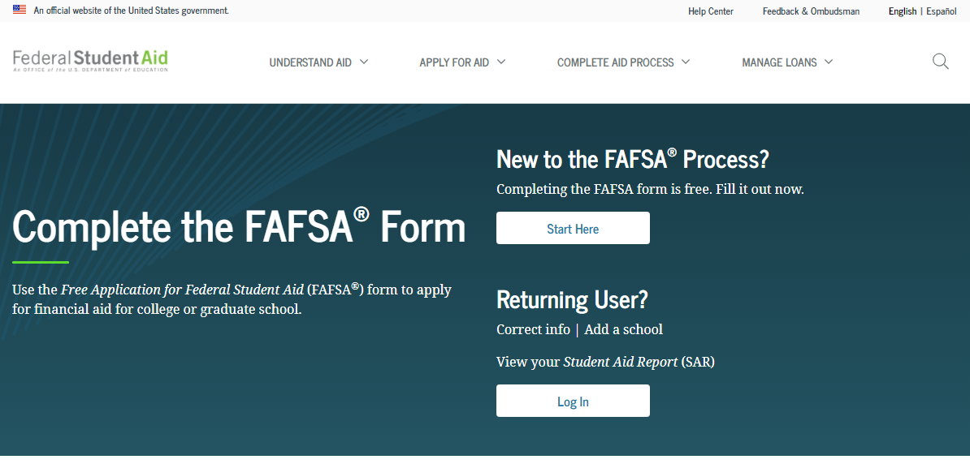

Slide 9
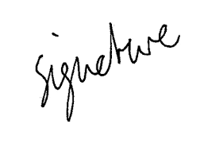
Signature Requirements
Both parent and student will need a Federal Student Aid ID (FSA ID) to electronically sign the application and you must use separate email addresses to set up the FSA ID.
Apply for the FSA ID prior to starting the application: studentaid.gov, and create an account
Will be used by students and parents throughout aid process, including subsequent school years

Slide 10
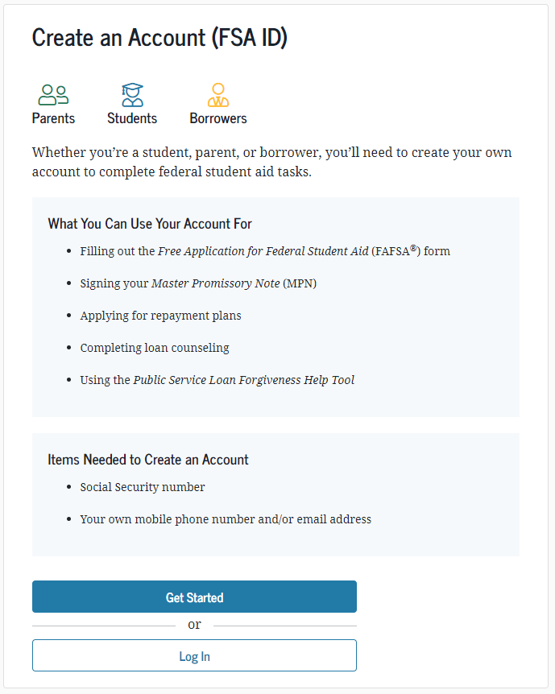
Signature Requirements
Only the owner should create the FSA ID

Slide 11
Filing
Use 2020 tax information
IRS Data Retrieval
Allows the transfer of parent and student tax data directly to the FAFSA
More accurate aid package
Schools are not able to accept copies of your tax returns; IRS Data Retrieval streamlines the process
Meet the deadlines. Do not wait for your student to be admitted as you may miss an important deadline

Slide 12
Frequent FAFSA Errors
Social Security Numbers
Divorced/widowed/remarried parental information
Income earned by parent/stepparent
Untaxed income
U.S. income taxes paid
Household size
Number of household members in college
Real estate and investment net worth

Slide 13
What is the EFC?
EFC = Expected Family Contribution
Amount family can be expected to contribute (discretionary income, borrowing ability, assets)

Slide 14
What is the EFC?
Two components
Parent contribution
Student contribution
Calculated using data from either the PROFILE and FAFSA or from just the FAFSA
EFC calculation may differ from school to school

Slide 15
Financial Need
Cost of Attendance
Minus Expected Family Contribution
Equals Financial Need

Slide 16
Financial Need: An Example
Tuition 46,460
Room/Board 13,510
Books 1,000
Personal/Transportation Expenses 1,400
Direct Loan Fee 68
Total 62,438
Minus
EFC 25,000
Equals Financial Need 37,438

Slide 17
Scholarships
Scholarships typically not based on financial need
Academic or talent components
Require full time enrollment and cumulative GPA for renewal
Do not need to be repaid

Slide 18
Grants
Grants – federal, state, institutional aid based on financial need and are not repaid
Federal Pell Grants, Federal SEOG (EFC < 5900)
VA TAG – based on residency

Slide 19
Grants
Institutional Grants—normally limited options at public institutions. Privates will have more resources
Awards may change from year to year if financial need changes

Slide 20
Loans
Loans – federal and private loans. Some require financial need and are repaid with interest
Federal Direct Subsidized and Unsubsidized Loans
Subsidized is need based and interest does not accrue while the student attends at least half time. Current interest rate is 3.73%
Unsubsidized is not based on need and interest does accrue immediately. Current interest rate is 3.73%

Slide 21
Loans
Federal Direct PLUS Loan
Federal loan program to help parents meet their EFC. Maximum eligibility is cost of attendance minus aid. Current interest rate is fixed at 6.28%

Slide 22
Loans
Private, Alternative Loans
Loan programs that allow students to meet their educational costs
Require a cosigner and the student must be 18
Interest rates are variable and usually with an index
Maximum eligibility is cost of attendance minus aid

Slide 23
Employment
Employment Opportunities
Federal Work Study based on financial need
Schools may have their own work program
Students normally work 8-10 hours a week and are paid directly for any hours worked

Slide 24
Award Notification
Financial aid packages are released once all forms have been submitted and the student has been accepted for admission
Single release date
Rolling release

Slide 25
Special Circumstances
Cannot be documented on the FAFSA, but the CSS Profile allows for documentation
Send written explanation and documentation to each financial aid office
College will review and request additional information if necessary
Decisions are final and cannot be appealed to U.S. Department of Education

Slide 26
Special Circumstances
Circumstances we are able to consider:
Change in employment status
Medical expenses not covered by insurance if greater than 11% of income
Change in parent marital status may apply pending document verification
Unusual dependent care expenses

Slide 27
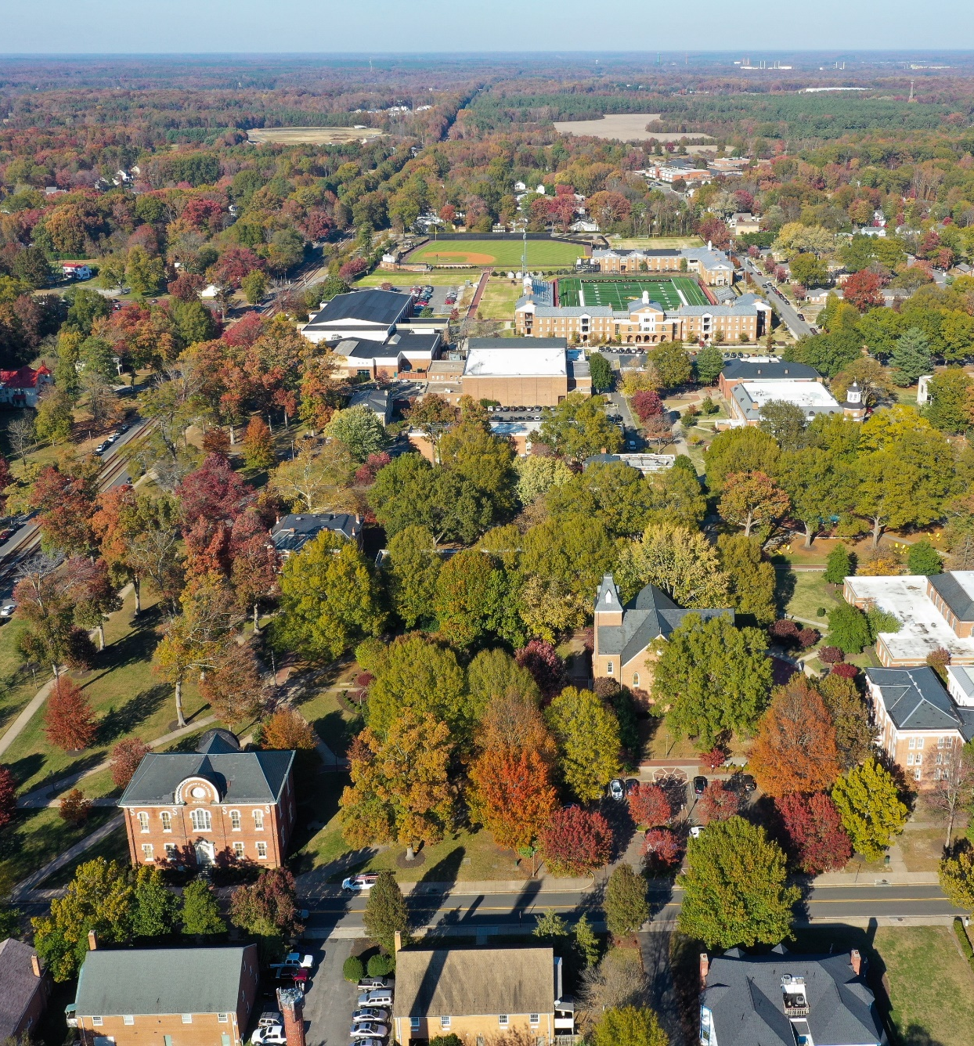
Special Circumstances
Circumstances we are unable to consider:
Consumer debt
Inability to liquidate assets
Cash flow problems

Slide 28
Appeal of Aid Package
Aid package is an offer
Aid packages are not negotiable, nor do colleges compete with other aid offers
Most colleges do have an appeal process
Nothing to lose, but be prepared, the answer may be no

Slide 29
Net Price Calculator
Mandated by the Department of Education
All schools must have on their website
Estimated information only and does not guarantee admission

Slide 30
Outside Scholarships
Explore outside agencies and local organization for awards
Check with your employer
www.fastweb.com
Scholarship Books
Kaplan Scholarships 20XX
Peterson’s Scholarships, Grants & Prizes 20XX

Slide 31
Contact Information
Julie Hickman-Godoy
Director, Financial Aid
Randolph-Macon College
juliehickmangodoy@rmc.edu
804.752.7259 (phone)
804.752.3719 (fax)
www.rmc.edu/finaid
financial-aid@rmc.edu

Slide 32
Meredith Kane Financial Aid Department

Slide 33
Why Reynolds?
1. Cost 2. Flexibility 3. Smaller class size 4. Variety

Slide 34
Community College Tuition $avings
Tuition & Fees for Full-time Students
(Excluding Room and Board Fees)
 |  |  |  |  | In-State resident
Colleges/Universities City of Richmond |  |  |  |  | Costs per credit hour |  |  | Costs per semester for 15 credit hours
Reynolds Community College (19-20) |  |  |  |  | 166.60 |  |  | $2,499.00
Virginia Commonwealth University (19-20) |  |  |  |  | $486.53 |  |  | $7,298
Virginia Union University (19-20) |  |  |  |  | $482.00 |  |  | $7765.00 (12 to 18 credits)
Randolph Macon College (18-19) |  |  |  |  |  |  |  | $20,600

Slide 35
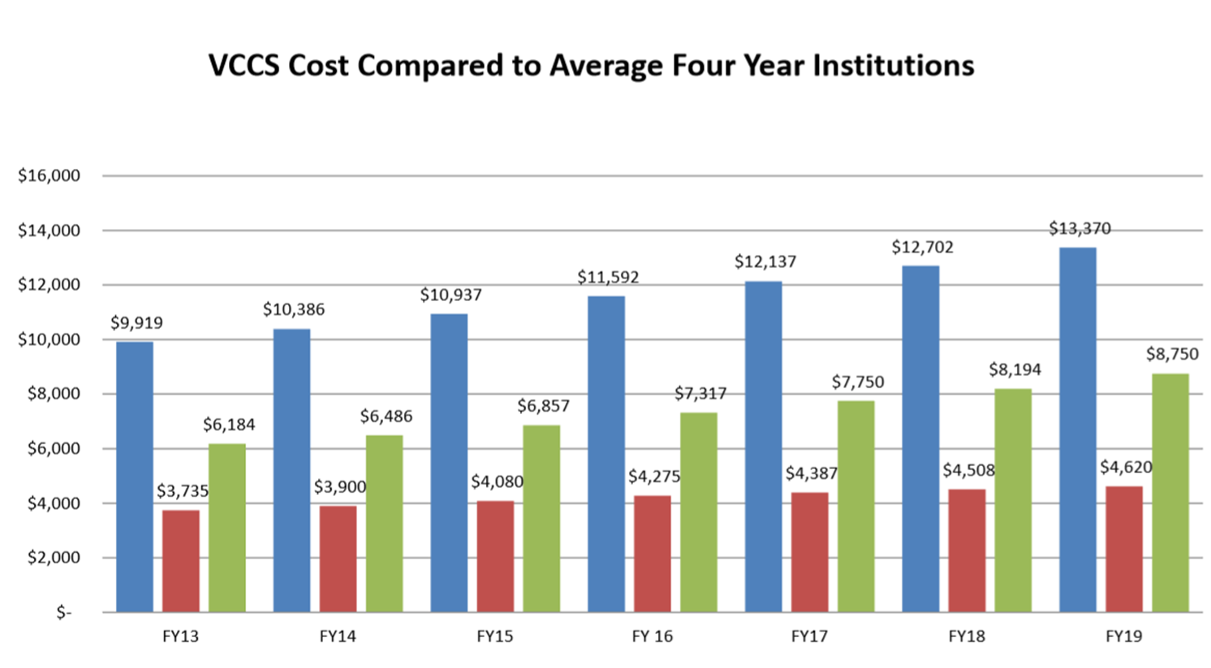

Slide 36
Program Options
Transfer Option – Associate degrees that are transferrable to four year institutions
Workforce Option – Skill-based degrees that are designed for direct entry into workforce in two years or less (certificate or Applied Associate degrees)

Slide 37
G3 -Get Skilled, Get a Job, Give Back
Healthcare, Information Technology, Manufacturing and Skilled Trades, Early Childhood Education, and Public Safety
Award:
Last dollar award up to tuition and fees
Bookstore allowance
For Full-time cannot exceed $500 per term
Student Support Incentive Grant (SSIG) – to qualify must be full-time (12 or more credits), eligible to receive full Pell Grant with a $0 EFC

Slide 38
Scholarships
- Awards $800,000
- Individual awards range from $100 to $4,000
- Average award: $1,500
- One application @ www.reynolds.edu/scholarships
- Open from December 1 – March 1
- Complete Admissions application and FAFSA
before completing Scholarship Application

Slide 39
The Honors Program at Reynolds
Transfer program students
College Placement (VPT; SAT (520M/500V); ACT (22M/21E))
3.5 high school GPA
Writing sample
2 letters of recommendation
Additional scholarship opportunities
http://www.reynolds.edu/get_started/honors/default.aspx

Slide 40
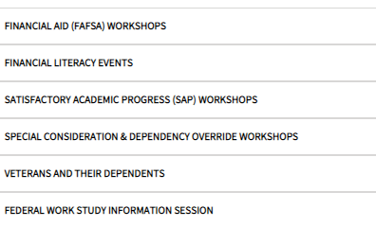
Financial Aid Workshops

Slide 41
Contact Information
Reynolds Scholarship
Email: scholarships@reynolds.edu
Phone: 804-523-5084
Reynolds Financial Aid Support
Email: finaid@Reynolds.edu
Phone: 855-874-6682
Notes:
Here is our contact information. If you have any questions or concerns in the future, please feel free to contact us. Thank you for joining us and we hope you have a wonderful semester!

Slide 42
Brenda Jackson

Slide 43
Post-Secondary Financial Aid

Slide 44
For more information:
Click here for Opportunities 21-22 Book
2021-22 version is now available in English and Spanish
www.grasp4va.org
2

Slide 45
GRASP Appointments
Brenda Jackson
JR Tucker Grasp Advisor
Jrtucker@grasp4va.org 804-214-6335
Wednesdays – In Person Appointments 9:00am – 3:00pm Please see the counseling secretary, Ms. Estes, to schedule an appointment
Tuesdays - Virtual Appointments 9:00am – 12:00pm
Please check the Tucker Website to sign-up using the following link:
www.tinyurl.com/jrtgraspsignup
Grasp4va.org
advising@grasp4va.org
804-527-7726

Slide 46
Questions?

Slide 47
CONTACT INFORMATION
GRASP Advisor, JR Tucker High School
https://grasp4va.org/
Brenda Jackson, email : jrtucker@grasp4virginia.org
Randolph Macon College
www.rmc.edu/finaid
Email: financial-aid@rmc.edu
804.752.7259
Reynolds Community College
http://www.reynolds.edu/pay_for_college/financial_aid/default.aspx
Email: Finaid@reynolds.edu
855-874-6682

